Slide 1
Android Development
Android Studio, Activities & Fragments

Slide 2
Goals
Develop a Weather App

Slide 3
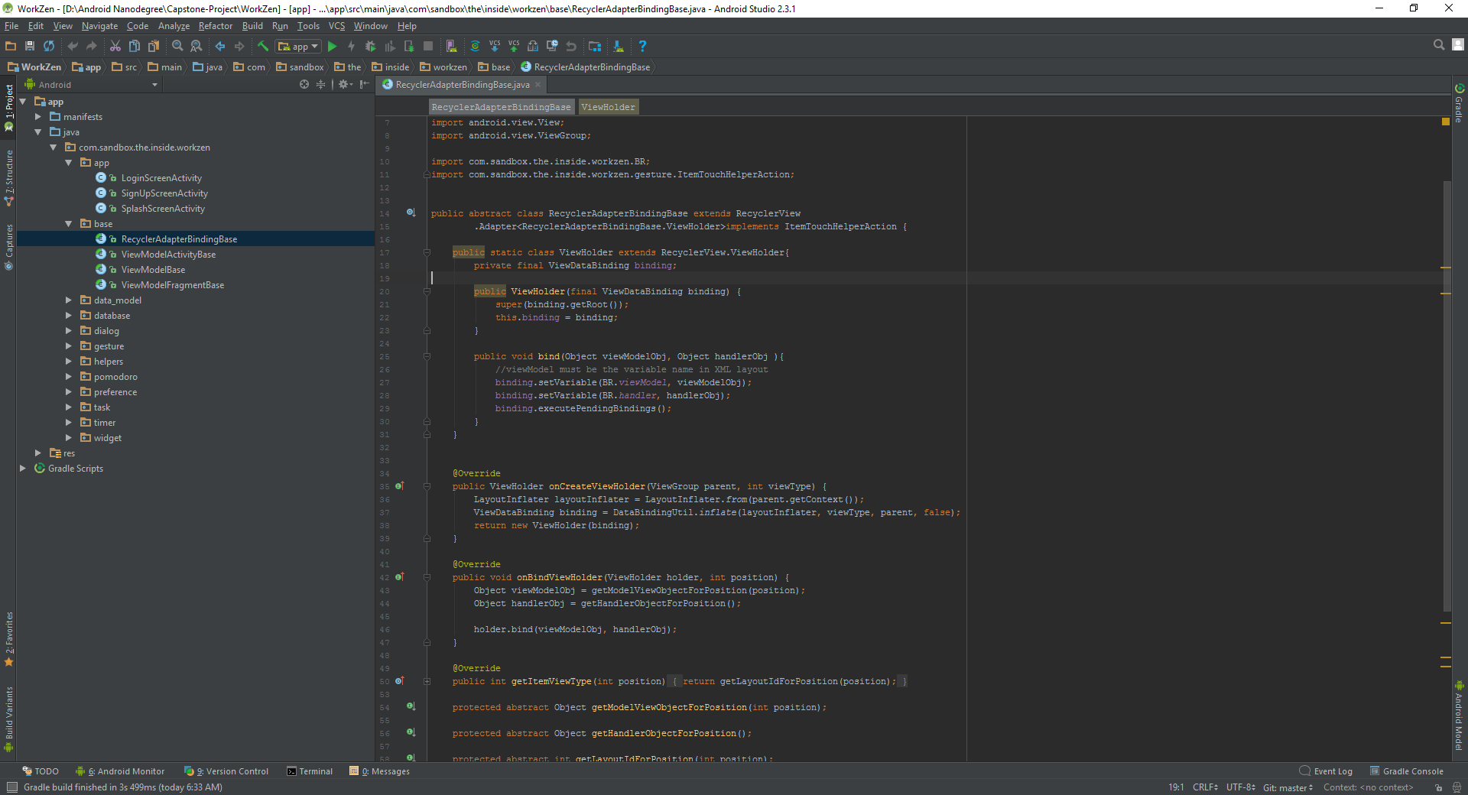
Android Studio
De facto standard for Android development
Built on the IntelliJ
Some features
Layout Editor
Built in emulator
Gradle integration
Instant Run (Hot swap)
https://developer.android.com/studio/index.html

Slide 4
Android Studio Parts

Slide 5

Activity https://developer.android.com/reference/android/app/Activity.html
Fundamental building blocks
Entry point for user's interaction
Provides navigates within an app
Communication between other activities
Communication between child fragments
No Creation or Modification of Views

Slide 6

Think of an Activity as a picture frame
Android placeholder
=

Slide 7
Fragment

